Slide 1
Area G Cleanup Presentation to the Regional Coalition of LANL Communities
Jay Coghlan
Nuclear Watch New Mexico
January 17, 2014
903 W. Alameda #325, Santa Fe, NM 87501 • 505.989.7342
info@nukewatch.org • www.nukewatch.org • http://www.nukewatch.org/watchblog/
http://www.facebook.com/NukeWatch.NM

Slide 2
Past Claims Implying Groundwater Contamination Was Impossible
Perched water bodies are formed by water infiltrating from canyon alluvium into underlying volcanics until it reaches an impermeable layer that prevents further downward movement…. (Emphasis added.)
http://www.osti.gov/bridge/servlets/purl/5476030-8c7bbL/
ENVIRONMENTAL SURVEILLANCE AT LOS ALAMOS DURING 1979
Page 10
Notes:
Perched water bodies are formed by water infiltrating from canyon alluvium into underlying volcanics until it reaches an impermeable layer that prevents further downward movement….
The main aquifer is isolated from alluvial water and perched water by about 110 to 190 m (350 to 620 ft) 10 of dry tuff and volcanic sediments. Thus there is no hydrologic connection or potential for recharge to the main aquifer from alluvial or perched water.

Slide 3
Past Claims
“Personnel from the Laboratory's Environmental Restoration Project have found preliminary indications of low levels of tritium in two perched groundwater zones - saturated areas that are segregated from the main aquifer by impermeable geologic formations - in Los Alamos Canyon.” (Emphasis added.)
http://www.lanl.gov/orgs/pa/News/121197text.html
Daily Newsbulletin
Thursday, Dec. 11, 1997
Notes:
Perched water bodies are formed by water infiltrating from canyon alluvium into underlying volcanics until it reaches an impermeable layer that prevents further downward movement….
The main aquifer is isolated from alluvial water and perched water by about 110 to 190 m (350 to 620 ft) 10 of dry tuff and volcanic sediments. Thus there is no hydrologic connection or potential for recharge to the main aquifer from alluvial or perched water.

Slide 4
The Reality of Existing Groundwater Contamination
“Cr(VI) releases from cooling towers during the period 1956 to 1972 have migrated to the regional drinking-water aquifer with concentrations exceeding EPA’s MCL by about 10 times.”
Hexavalent Chromium Contamination in Deep Groundwater Beneath LANL, Michael Dale et al, NMED DOE Oversight Bureau, 2012 EPA Training Program.
“Contaminants detected in groundwater include explosives; volatile organic compounds such as TCE; metals such as beryllium, lead and mercury; perchlorate; and other contaminants. Contaminants have been detected beneath the Facility in all four groundwater zones.”
NMED/LANL Order on Consent, March 2005, ”Findings of Fact,” page 5 (paraphrased).

Slide 5
If Not Cleaned Up, Increasing Groundwater Contamination Is Inevitable
“Future contamination at additional locations is expected over a period of decades to centuries as more of the contaminant inventory reaches the water table.”
LANL Hydrogeologic Studies of the Pajarito Plateau:
A Synthesis of Hydrogeologic Workplan Activities (1998–2004),
ER2005-0679 December 2005, Page 5-15

Slide 6
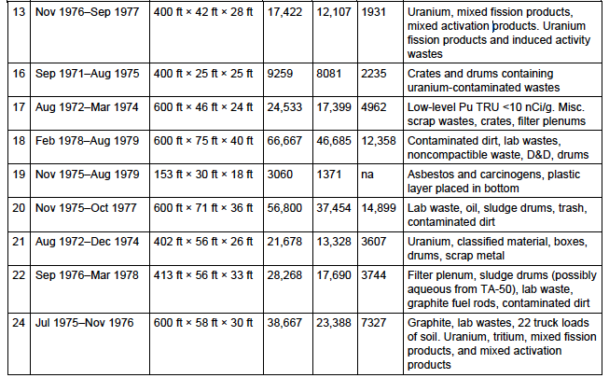
Incomplete Area G Records Reveal Huge List of Contaminants
This list goes on for 10 pages.

Slide 7
Waste + Backfill = 1 Million Cubic Yards (Approx. Volume of Empire State Building)
Notes:
This chart does not have all the pits (missing 38 and 39), or any trenches or shafts.
All the backfill is considered reusable.
1,491,253 cubic yard = 1,140,144.7 cubic meter.
898,924 cubic yard = 687,276.7 cubic meter

Slide 8
Solvent Plume Spreading from Area G (Abutting San Ildefonso Pueblo Lands)

Slide 9
Solvent Plume Has Migrated 200 Feet Toward Aquifer

Slide 10
Pu, Am, H³, Co-60 Surrounding Area G (Abutting San Ildefonso Pueblo Lands)

Slide 11
Limited Borehole Sampling For Rads Under Area G

Slide 12
Plutonium Has Migrated 200 Feet Under Area G

Slide 13
Complex Geology Not Fully Known Multiple Contaminant Pathways to Aquifer

Slide 14
The Case for Cleanup: NNSA/LANS Must Re-Examine Costs
• LANL’s Sept. 2011 Corrective Measures Evaluation estimated $29.5 billion
- “Full Excavation Design” $992 million
- “Project Mgt” $7 billion - Labor $13.6 billion
Contingency $9.7 billion
• Nuclear Watch’s comparison using Area B actual cleanup costs = $6 - $7 billion.
http://www.nukewatch.org/facts/nwd/Area_G_Comparison_Costs-11-14-12.pdf

Slide 15
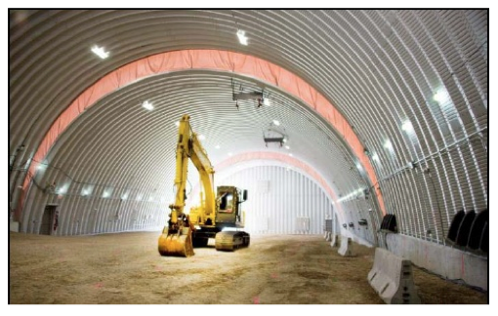
Occupational and Environmental Safety
• No explosives listed in Area G inventory.
• No reported serious injuries or worker contamination in LANL’s 3706 Campaign.
• Area B cleanup:
No reported serious
injuries or contamination.
• Area B: excavation was
environmentally contained
in a rolling Quonset hut.

Slide 16
Jobs, Jobs, Jobs!
• The ~$6 billion CMRR Nuclear Facility would have produced NO new permanent jobs.
CMRR Final EIS, NNSA, August 2011, Volume 1, page 2-55, explaining it would have merely relocated existing Lab jobs.
• While addressing only a small fraction of Area G cleanup, the 3706 Campaign currently employs 400 workers.
Dan Cox, LANL 3706 Campaign manager, Dec. 13, 2013 RCLC meeting.
• Comprehensive cleanup of Area G would be a true win-win for New Mexicans, permanently protecting our precious water while creating hundreds of well-paying jobs for 20 – 30 years.

Slide 17
LANL Sampling on Mars
P.S. Area G is a lot closer.
Notes:
ChemCam (pictured in the illustration) is mounted on the rover's mast and uses extremely powerful pulses of laser light to vaporize pinhead-sized areas of the Martian surface from as far away as 23 feet. The tiny flashes created by these pulses will be analyzed by a spectrometer to provide scientists with crucial information about the composition of Mars surface materialsCheMin uses X-ray diffraction to determine the composition of samples that are collected and dropped into a funnel on the roverVaporizing Martian rockOne instrument, known as ChemCam, is mounted on the rover’s mast and will use extremely powerful pulses of laser light to vaporize pinhead-sized areas of the Martian surface from as far away as 23 feet. The tiny flashes created by these pulses will be analyzed by a spectrometer to provide scientists with crucial information about the composition of Mars rocks.2:12ChemCam rock laser for Mars Science Laboratory“ChemCam is designed to look for lighter elements such as carbon, nitrogen, and oxygen, all of which are crucial for life,” said Roger Wiens, principal investigator of the MSL mission’s ChemCam team. “The system can provide immediate, unambiguous detection of water from frost or other sources on the surface, as well as carbon—a basic building block of life as well as a possible byproduct of life. This makes the ChemCam a vital component of Curiosity’s mission.” Another instrument, CheMin, will use X-ray diffraction to determine the composition of samples that are collected and dropped into a funnel on the rover.
http://www.lanl.gov/science-innovation/science-features/mars-rover-powered-lanl-technology.php

