Slide 1
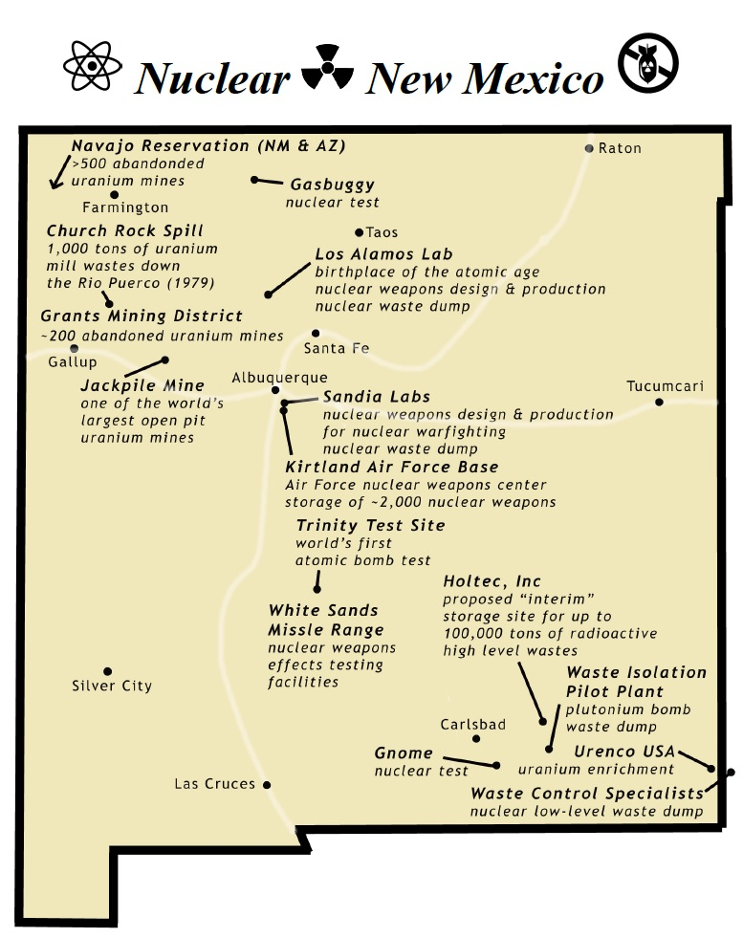
Dismantling the Nuclear Beast
Jay Coghlan,
Director
Nuclear Watch New Mexico
December 2, 2017
info@nukewatch.org
www.nukewatch.org

Slide 2

Nuclear Weapon Ban Treaty
Prohibits the development, testing, production, stockpiling, stationing, transfer, use and threat of use of nuclear weapons
53 signatories to date
U.S. and other nuclear weapons powers staunchly oppose
• ICAN - Nobel Peace Prize

Slide 3
Nuclear Weapons in NM = $4B/yr
$10.2 billion - - National Nuclear Security Administration FY 2018 nuclear weapons request.
• NNSA’s nuclear weapons budget in NM is increasing
FY 2016 = $3.8B
FY 2017 = $3.5B
FY 2018 = $4.0B (40% of nation-wide NNSA spending)
Total Department of Energy budget in NM for FY 2018
$5.4B (NM State operating budget is ~$6.1 billion)
74% of DOE Spending in NM Is for nuclear weapons

Slide 4
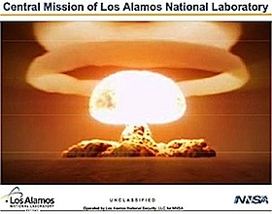
LANL Central Mission

Slide 5
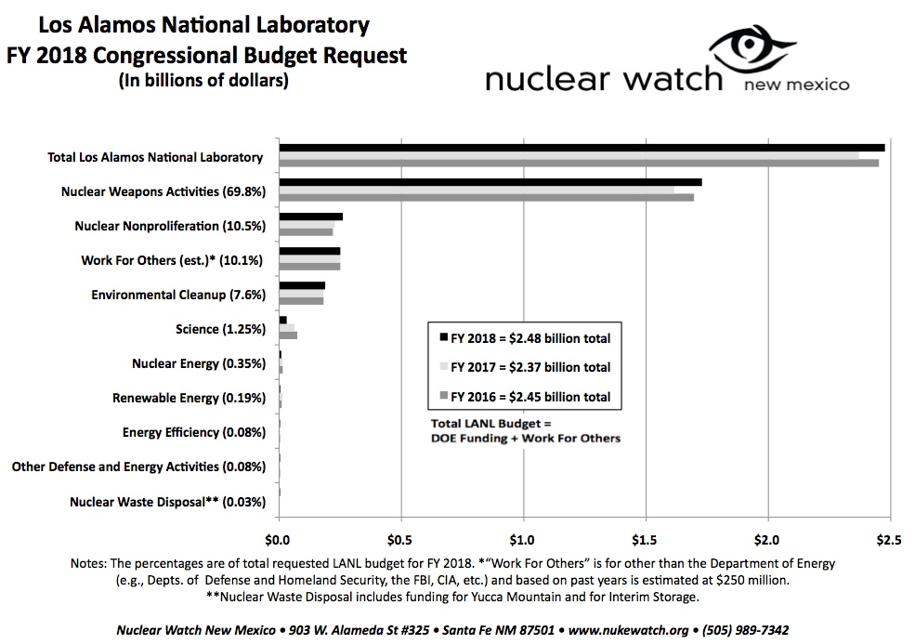
LANL Nuclear Weapons = $1.7B/year

Slide 6
Expanded plutonium pit production at LANL
Plutonium pits are the fissile cores of nuclear weapons. No production is scheduled for the existing stockpile.
Nevertheless, Congress requires capability for 80 pits per year by 2027 (up from 20). Sen. Udall and Heinrich in full support.
Future production is for 3 types of “Interoperable Warheads” that will cost ~$50B and the Navy doesn’t want.

Slide 7
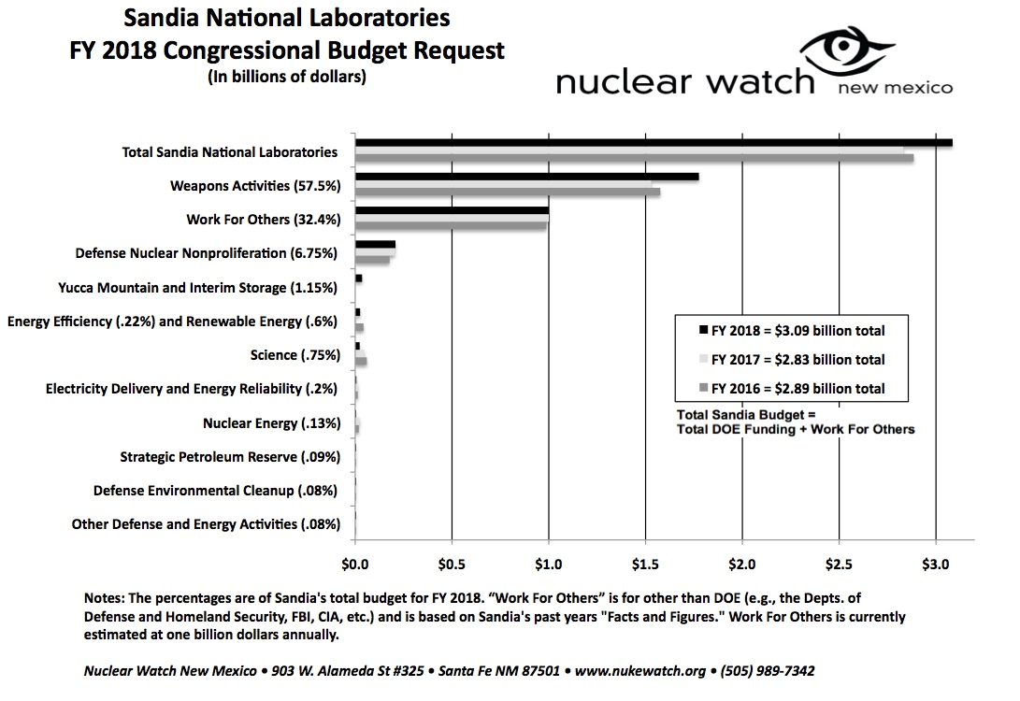
Sandia Nuclear Weapons = $1.8B/year

Slide 8
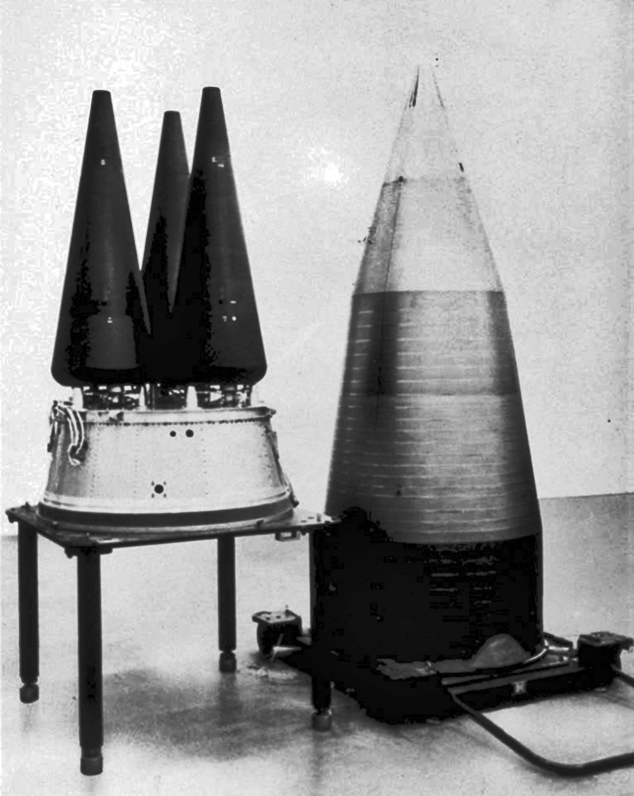
$1.7 Trillion “Modernization”
New ICBMs, Heavy Stealth Bombers, Cruise Missiles, Submarines
Rebuilt Nuclear Warheads with New Military Capabilities
Perpetual Cycle of “Life Extension Programs”

Slide 9
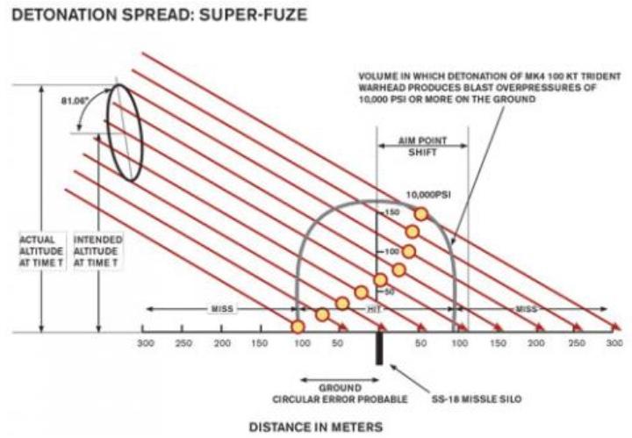
Triple Lethality of US Nuclear Weapons Stockpile
How US nuclear force modernization is undermining strategic stability: The burst-height compensating super-fuze
Hans M. Kristensen, Matthew McKinzie, Theodore A. Postol
1 MARCH 2017
https://thebulletin.org/how-us-nuclear-force-modernization-undermining-strategic-stability-burst-height-compensating-super10578

Slide 10
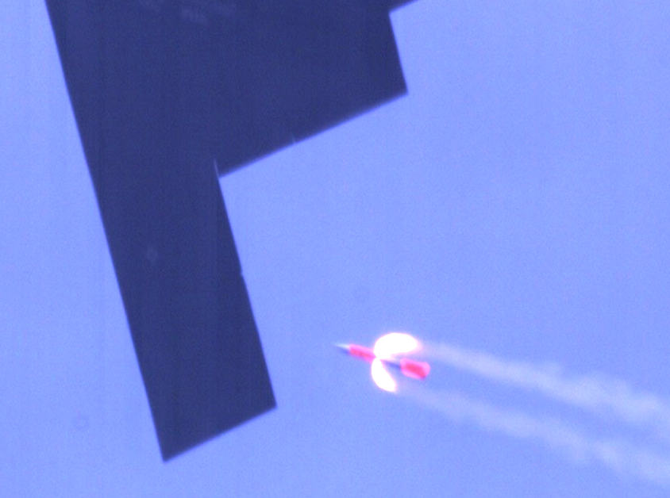
Trump Nuclear Posture Review
Due end of January 2018?
Expected to end ban on new nuclear weapons designs and new military capabilities
Likely new, more “usable” mini-nukes

Slide 11
The three-fold rationale for nuclear weapons programs in NM is:
Jobs, Jobs, Jobs.
We will never break the stranglehold that nuclear weapons programs have over NM politicians until we can posit alternative jobs.
No silver bullets
However, genuine, comprehensive cleanup at LANL would produce hundreds of high paying jobs, a real win-win while protecting our water and environment.

Slide 12
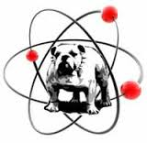
Contact us at www.nukewatch.org
Nuclear Watch New Mexico
903 W. Alameda #325
Santa Fe, NM, 87501
505.989.7342 office & fax
info@nukewatch
www.nukewatch.org
http://www.nukewatch.org/watchblog/
Notes:
Invite CAB to use us

